Slide 1
Strategy Pattern

Slide 2
Intent
Define a family of algorithms, encapsulate each one, and make them interchangeable.
Strategy lets the algorithm vary independently from clients that use it.

Slide 3
The Strategy pattern suggests keeping the implementation of each of the algorithms in a separate class.
Each such algorithm encapsulated in a separate class is referred to as a strategy.
An object that uses a Strategy object is often referred to as a context object.

Slide 4
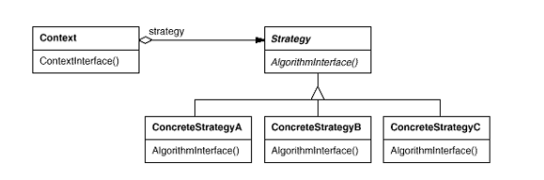
Structure

Slide 5
Difference Between State and Strategy
Different types of possible behavior of an object are implemented in the form of a group of separate objects. | Similar to the State pattern, specific behaviors are modeled in the form of separate classes.
The choice of a State object is dependent on the state of the Context object. | The choice of a strategy object is based on the application need.

Slide 6
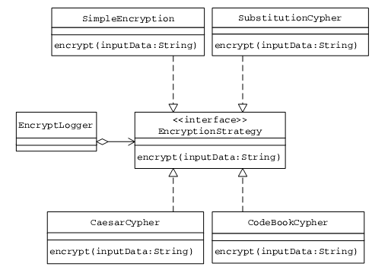
Example (ref Partha Kuchana book)

Slide 7
Example in Java (Strategy)
public interface SortInterface {
public void sort(double[] list);
}

Slide 8
Example in Java (ConcreteStrategy )
public class QuickSort implements SortInterface {
public void sort(double[] a) {
quicksort(a, 0, a.length - 1);
}
private void quicksort(double[] a, int left, int right) {
if (right <= left) return;
int i = partition(a, left, right);
quicksort(a, left, i-1);
quicksort(a, i+1, right);
}
private int partition(double[] a, int left, int right) {
int i = left;
int j = right;
while (true) {
while (a[i]< a[right])
i++;
while (less(a[right], a[--j]))
if (j == left) break;
if (i >= j) break;
exch(a, i, j);
}

Slide 9
Example in Java (ConcreteStrategy )
exch(a, i, right);
return i;
}
private boolean less(double x, double y) {
return (x < y);
}
private void exch(double[] a, int i, int j) {
double swap = a[i];
a[i] = a[j];
a[j] = swap;
}
}

Slide 10
Example in Java (ConcreteStrategy )
public class BubbleSort implements SortInterface {
public void sort(double[] list) {
double temp;
for(int i = 0; i < list.length; i++) {
for(int j = 0; j < list.length - i; j++) {
if(list[i] < list[j]) {
temp = list[i];
list[i] = list[j];
list[j] = temp;
}
}
}
}
}

Slide 11
Example in Java (Context )
public class SortingContext {
private SortInterface sorter = null;
public void sortDouble(double[] list) {
sorter.sort(list);
}
public SortInterface getSorter() {
return sorter;
}
public void setSorter(SortInterface sorter) {
this.sorter = sorter;
}
}

Slide 12
Example in Java (Client )
public class SortingClient {
public class SortingClient {
public static void main(String[] args) {
double[] list = {1,2.4,7.9,3.2,1.2,0.2,10.2,22.5,19.6,14,12,16,17};
SortingContext context = new SortingContext();
context.setSorter(new BubbleSort());
context.sortDouble(list);
for(int i =0; i< list.length; i++) {
System.out.println(list[i]);
}
}
}

Slide 13
Another Example in Java
public interface Strategy {
boolean checkTemperature(int temperatureInF);
}
public class HikeStrategy implements Strategy {
boolean checkTemperature(int temperatureInF) {
if ((temperatureInF >= 50) && (temperatureInF <= 90)) {
return true; }
else {
return false; }
}
}

Slide 14
Another Example in Java
public class SkiStrategy implements Strategy {
boolean checkTemperature(int temperatureInF) {
if (temperatureInF <= 32) {
return true; }
else {
return false; }
}
}

Slide 15
Another Example in Java
public class Context {
int temperatureInF;
Strategy strategy;
public Context(int temperatureInF, Strategy strategy) { this.temperatureInF = temperatureInF;
this.strategy = strategy; }
public void setStrategy(Strategy strategy) {
this.strategy = strategy; }
public int getTemperatureInF() {
return temperatureInF; }
public boolean getResult() {
return strategy.checkTemperature(temperatureInF); }
}

Slide 16
Another Example in Java
public class Demo {
public static void main(String[] args) {
int temperatureInF = 60;
Strategy skiStrategy = new SkiStrategy();
Context context = new Context(temperatureInF, skiStrategy); System.out.println("Is the temperature (" + context.getTemperatureInF() + "F) good for skiing? " + context.getResult());
Strategy hikeStrategy = new HikeStrategy(); context.setStrategy(hikeStrategy);
System.out.println("Is the temperature (" + context.getTemperatureInF() + "F) good for hiking? " + context.getResult());
} }

Slide 17
Another Example in Java
Output:
Is the temperature (60F) good for skiing? false
Is the temperature (60F) good for hiking? true

